Slide 1
CSS - Training

Slide 2
Agenda
CSS Introduction
CSS Syntax understanding
CSS Selectors
Different Ways of Applying CSS in HTML
CSS Properties – Deep Dive
Building Various Navigation List
Styling HTML Forms

Slide 3
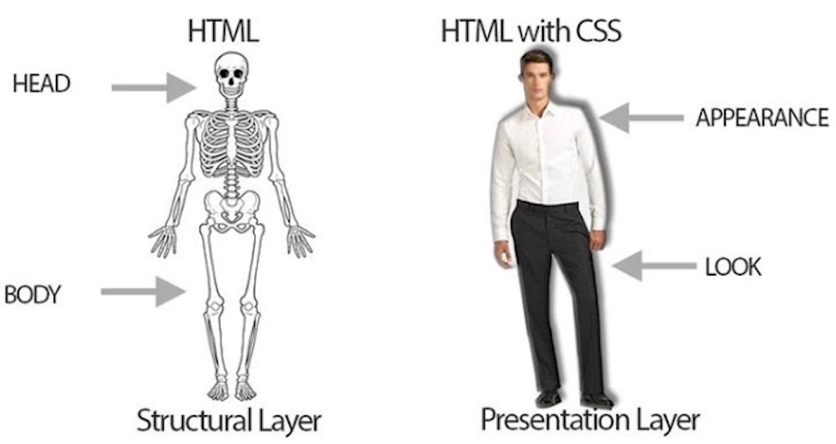
What is CSS?
CSS stands for Cascading Style Sheets.
It is used to style HTML documents to make it good looking.
Turn ordinary black & white page into colorful one.
Can make webpage as a Responsive one.

Slide 4
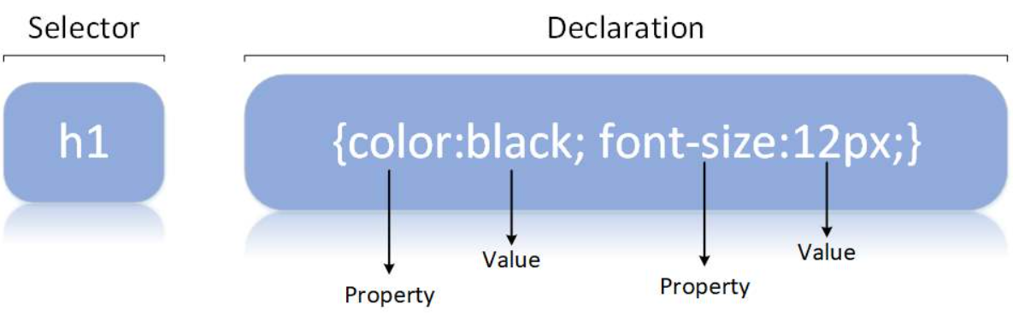
CSS Syntax
A CSS rule consists of a selector and a declaration block.
The selector points to the HTML element you want to style.
The declaration block contains one or more declarations separated by semicolons.

Slide 5
Different Ways of Adding CSS
There are three ways of inserting a style sheet:
External CSS (in the head section)
Internal CSS (in the head section)
Inline CSS (inside an HTML element)
External CSS :
With an external style sheet, you can change the look of an entire website by changing just one file
<!DOCTYPE html> <html> <head> <link rel="stylesheet" href="mystyle.css"> </head> <body> </body> </html>

Slide 6
Different Ways of Adding CSS
Intenal CSS :
An internal style sheet may be used if one single HTML page has a unique style.
The internal style is defined inside the <style> element, inside the head section.
<html> <head> <style> body { background-color: linen; } h1 { color: maroon; margin-left: 40px; } </style> </head> <body> <h1>This is a heading</h1> <p>This is a paragraph.</p> </body> </html>

Slide 7
Different Ways of Adding CSS
Inline CSS :
An inline style may be used to apply a unique style for a single element, to use inline styles, add the style attribute to the relevant element.
<!DOCTYPE html> <html> <body> <h1 style="color:blue;text-align:center;">This is a heading</h1> <p style="color:red;">This is a paragraph.</p> </body> </html>

Slide 8
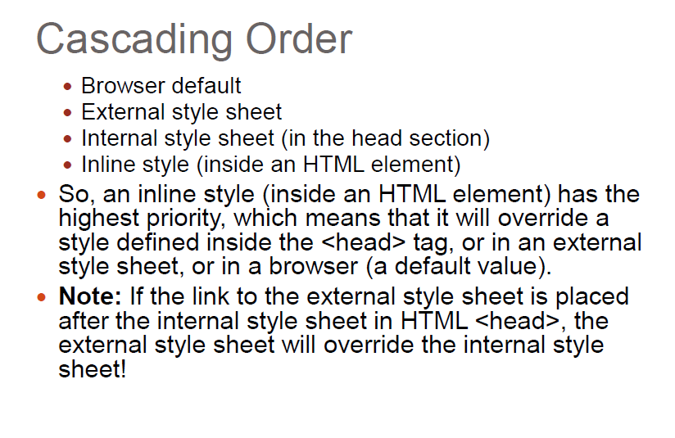
CSS Order

Slide 9
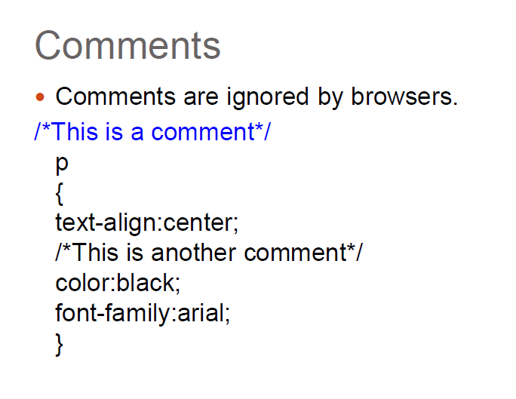
CSS Comment

Slide 10
CSS Basic Selectors
A CSS selector selects the HTML element(s) which we want to style
Types of Selectors:
CSS element Selector
CSS id Selector
CSS class Selector
CSS Universal Selector
CSS Grouping Selector

Slide 11
CSS Selectors
CSS element Selector: - The element selector selects HTML elements based on the element name
CSS id Selector - id selector uses the id attribute of an HTML element to select a specific element
CSS class Selector - Class selector selects HTML elements with a specific class attribute
p { text-align: center;
color: red; }
#textBoxName{ text-align: center; color: red; }
.portal { text-align: center; color: black; }

Slide 12
CSS Selectors
CSS Universal Selector: - CSS rule below will affect every HTML element on the page
CSS Grouping Selector
* { text-align: center; color: blue; }
h1 { text-align: center; color: red; } h2 { text-align: center; color: red; } p { text-align: center; color: red; }
h1, h2, p { text-align: center; color: red; }

Slide 13
Advanced CSS Selector
Combinators Selector
Descendant Selector
Direct Child Selector
Adjacent sibling Selector
General sibling Selectors

Slide 14
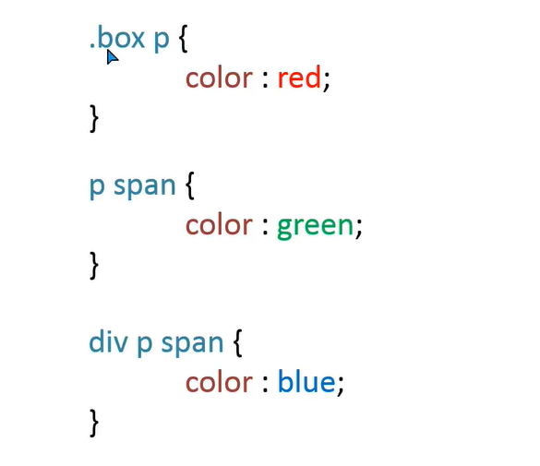
Combinators – Descendant Selector

Slide 15
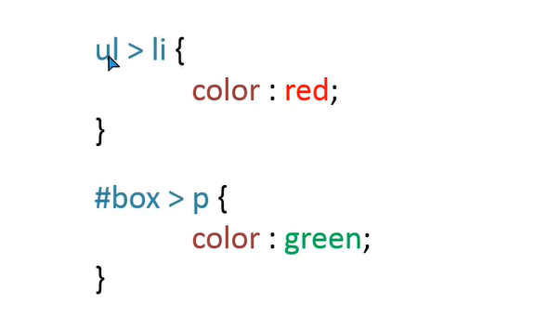
Combinators – Direct Child Selector

Slide 16
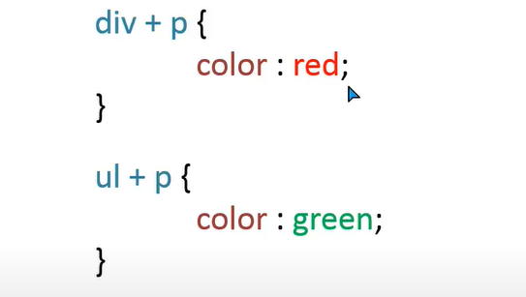
Combinators – Adjacent Sibling Selector

Slide 17
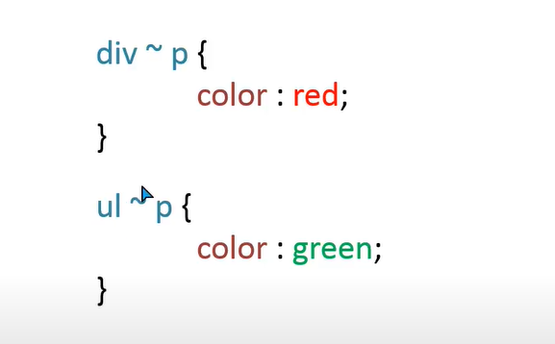
Combinators – General Sibling Selectors

Slide 18
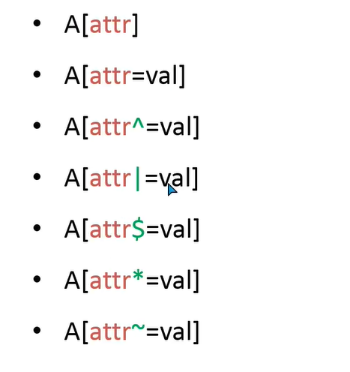
Advanced CSS Selector
Attribute Selectors

Slide 19
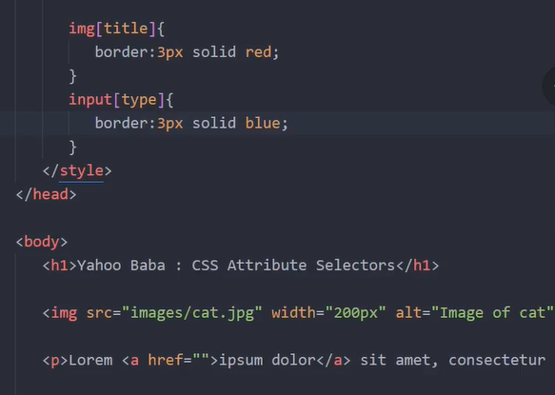
A[attr] – targeting attribute

Slide 20
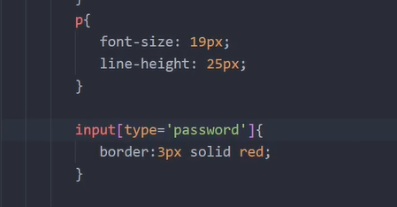
A[attr=val] – matching value

Slide 21
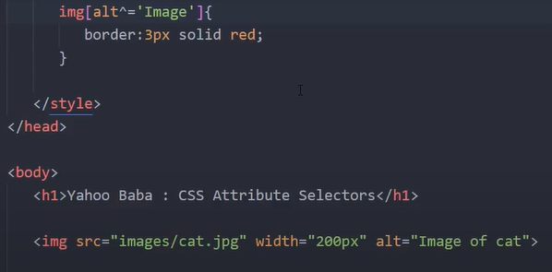
A[attr=^val] – should start with this value

Slide 22
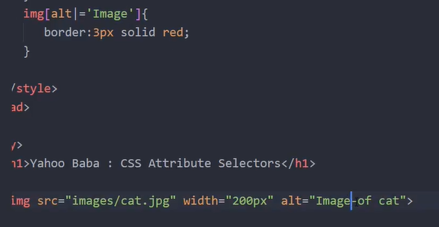
A[attr=|val] – value should have hypen after that

Slide 23
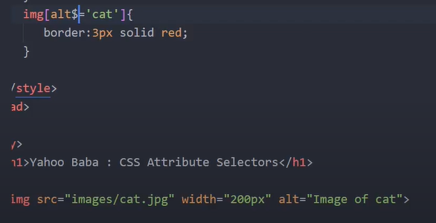
A[attr=$val] – value end with this value

Slide 24
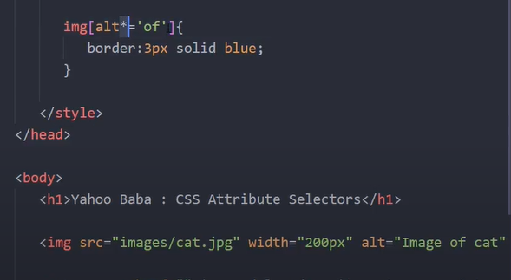
A[attr=*val] – match with value anywhere

Slide 25
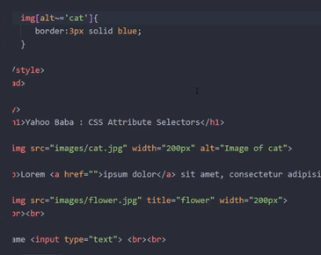
A[attr=~val] – similar like * but space should be there between word

Slide 26
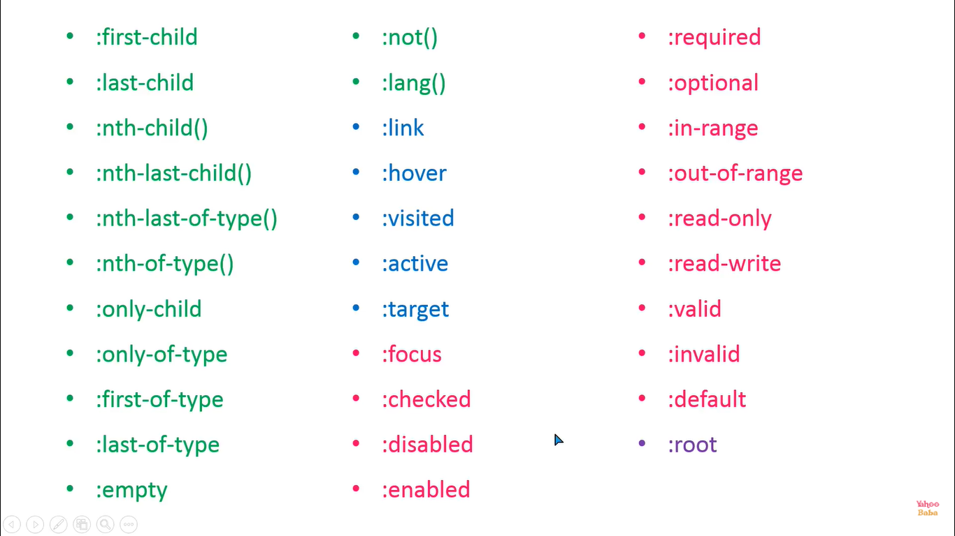
Pseudo Classes

Slide 27
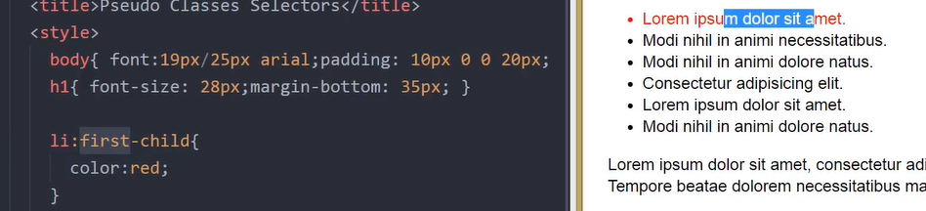
PseudoClass:first-child

Slide 28
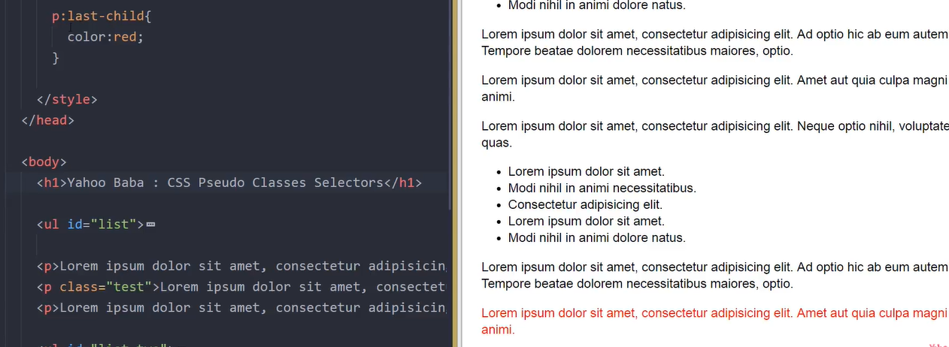
PseudoClass:last-child

Slide 29
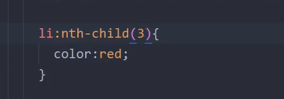
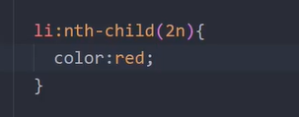
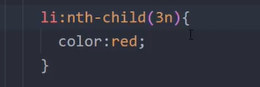
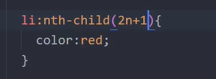
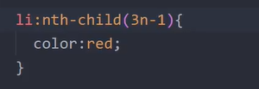
PseudoClass:nth-child()-to target element in sequence

Slide 30
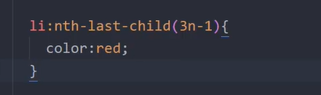
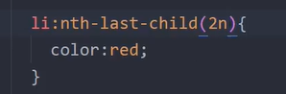
PseudoClass:nth-last-child()-to target element from last in sequence

Slide 31
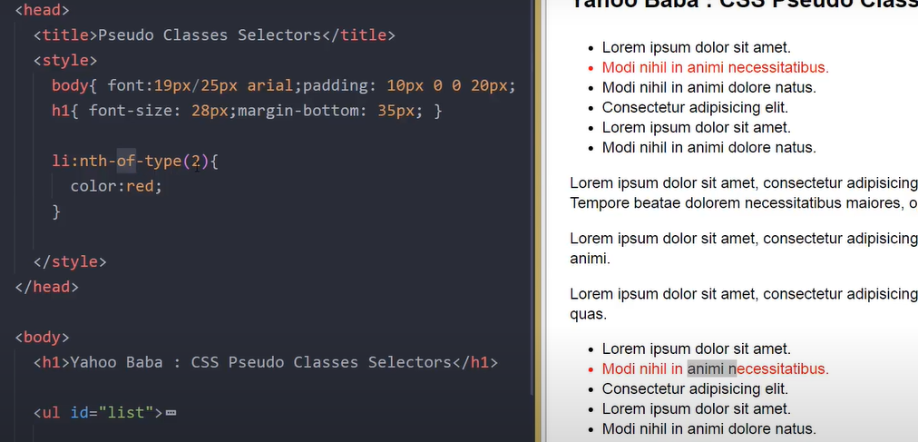
PseudoClass: nth-of-type() – any type but it will concentrate on particular element

Slide 32
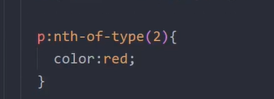
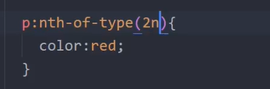
PseudoClass: nth-of-type() – without child as well it will target

Slide 33
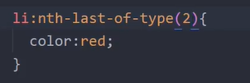
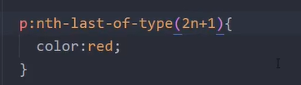
PseudoClass: nth-last-of-type() – without child as well it will target

Slide 34
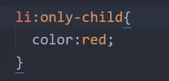
PseudoClass: only-child() - only that particular child only (only one child)

Slide 35
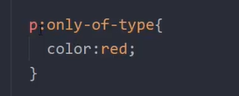
PseudoClass: only-of-type()- only that particular tag one time is there but other tag we can have it

Slide 36
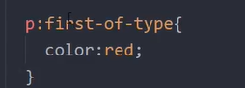
PseudoClass: first-of-type()-it will select first element with or without parent

Slide 37
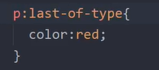
PseudoClass: last-of-type()-it will select last element with or without parent

Slide 38
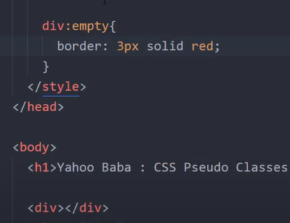
PseudoClass: empty – any empty tag without content without white space

Slide 39
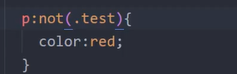
PseudoClass: not()- excepting that paritcular element

Slide 40
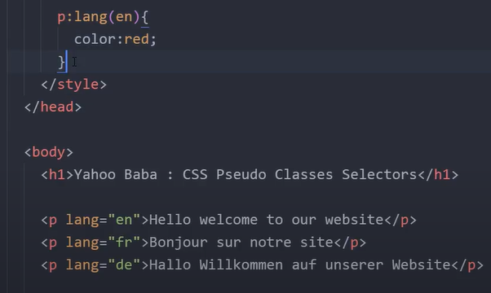
PseudoClass: lang()-targeting particular language

Slide 41
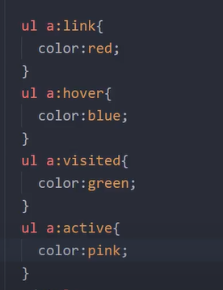
PseudoClass: link(),hover(),active(),visited() – used for anchor tag

Slide 42
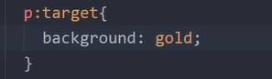
PseudoClass: target() – used for anchor

Slide 43
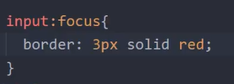
PseudoClass: focus() – forms

Slide 44
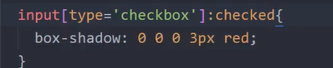
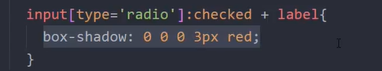
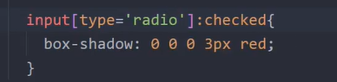
PseudoClass:checked() – forms

Slide 45
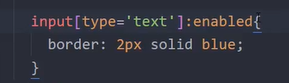
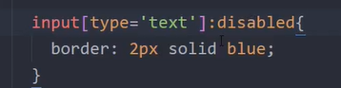
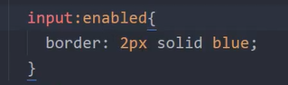
PseudoClass: – enable() and disabled() forms

Slide 46
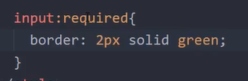
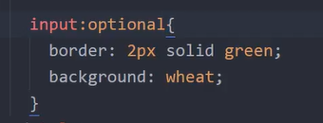
PseudoClass: – required() and optional() forms

Slide 47
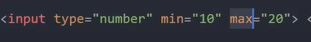


PseudoClass: – in-range() and out-of-range() forms

Slide 48


PseudoClass: – read-only() and read-write() forms

Slide 49




PseudoClass: – valid() and invalid() forms

Slide 50


PseudoClass: – default() forms – checkbox,radio,select

Slide 51

PseudoClass: – root()

Slide 52

Pseudo -Elements

Slide 53

Pseudo –Elements – first-letter()

Slide 54

Pseudo –Elements – first-line()

Slide 55


Pseudo –Elements – selection()

Slide 56

Pseudo –Elements – selection()

Slide 57

Box Modal

Slide 58


CSS Property – Height & Width
Height and Width - The CSS height and width properties are used to set the height and width of an element.
Individual Sides
div { height: 100px; width: 500px; background-color: powderblue; }
div { height: 200px; width: 50%; background-color: powderblue; }

Slide 59
CSS Property - Border
Borders - The CSS border properties allow you to specify the style, width, and color of an element's border
Border Style – dotted, dashed, solid, double -
Border Width -
Border Color –
Border Sides
Shorthand Border Property -
Rounded Borders -
p {border-style: solid;}
p {border-width: 5px;}
p {border-color: red;}
p { border-top-style: dotted; border-right-style: solid; border-bottom-style: dotted; border-left-style: solid; }
p {border: 5px solid red;}
p {border-radius: 5px;}

Slide 60
CSS Property - Padding
Padding - Padding is used to create space around an element's content, inside of any defined borders
Individual Sides
Shorthand Property -
div { padding-top: 50px; padding-right: 30px; padding-bottom: 50px; padding-left: 80px; }
p { padding: 25px 50px 75px 100px; }
div{padding: 25px 50px;}
div {padding: 25px;}

Slide 61
CSS Property - Margin
Margins - Margins are used to create space around elements, outside of any defined borders
Individual Sides
Shorthand Property -
auto Value - set the margin property to auto to horizontally center the element within its container
p { margin-top: 100px; margin-bottom: 100px; margin-right: 150px; margin-left: 80px; }
p {margin: 25px 50px 75px 100px;}
div { width: 300px; margin: auto; border: 1px solid red; }

Slide 62
CSS Properties
Colors - Colors are specified using predefined color names, or RGB, HEX, HSL, RGBA, HSLA values.
Text Color
Border Color
Background Color
Color Values - In CSS, colors can also be specified using RGB values, HEX values, HSL values:
<h1 style="color:blue;">Hello World</h1>
<h1 style="border:2px solid Tomato;">Hello World</h1>
<h1 style="background-color:DodgerBlue;">Hello World</h1>
Tomato
rgb(255, 99, 71)
#ff6347
hsl(9, 100%, 64%)

Slide 63
CSS Property - Background
Backgrounds - CSS background properties are used to add background effects for elements.
background-color
Background Image
Background-repeat
Background Shorthand
div { background-color: lightblue; }
div {background-image: url("bgWallppr.jpg"); }
body { background-image: url("img_tree.png"); background-repeat: no-repeat;
Background-size:100px 200px;
Background-size:cover; }
div {background: #ffffff url("img_tree.png") no-repeat;}

Slide 64
CSS Property - Fonts
Fonts
font-family
font-style
font-weight
font-size
p {font-family: "Times New Roman", Times, serif; }
p {font-style: italic;}
p {font-weight: bold;}
p {font-size: 14px;}

Slide 65

CSS Property - Text

Slide 66

CSS Property – Link Properties

Slide 67
Text Effects
Text-overflow
Word-wrap
Word-break
Writing-mode

Slide 68


text-overflow:clip

Slide 69


text-overflow:ellipsis

Slide 70


Overflow:visible

Slide 71

Word-wrap:break-word

Slide 72

Word-break

Slide 73

Word-break

Slide 74

CSS Property – Text overflow

Slide 75



CSS Property - Float
Float - The CSS float property specifies how an element should float.
float: left
float: right
float: none
img {
float: left;
}
img { float: right; }
img { float: none; }

Slide 76


CSS – Navigation using List
Navigation – It will help the user to navigate to the different page of the application easily.
Simple Navigation bar
Vertical Navigation Bar
<ul> <li><a href=“home.html">Home</a></li> <li><a href=“news.html">News</a></li> <li><a href="contact.html">Contact</a></li> <li><a href="about.html">About</a></li> </ul>
ul { list-style-type: none; margin: 0; padding: 0; }
<ul> <li><a href=“home.html">Home</a></li> <li><a href=“news.html">News</a></li> <li><a href="contact.html">Contact</a></li> <li><a href="about.html">About</a></li> </ul>
ul { list-style-type: none; margin: 0; width: 200px; padding: 0; background-color: #f1f1f1; }
li a {
display: block;
color: #000;
padding: 8px 16px;
text-decoration: none;
}

Slide 77

CSS – Navigation using List
Horizontal Navigation bar
ul {
list-style-type: none;
margin: 0;
padding: 0;
background-color: #E7E9EB;
}
li {
float: left;
}
li a {
display: block;
color: black;
text-align: center;
padding: 14px 16px;
text-decoration: none;
}
li a:hover {
background-color: #04AA6D;
}
.active {
background-color: #04AA6D;
}
<ul> <li><a class="active" href=“home.html">Home</a></li> <li><a href=“news.html">News</a></li> <li><a href="contact.html">Contact</a></li> <li><a href="about.html">About</a></li> </ul>

Slide 78

CSS – Position

Slide 79

Flex box and grid

Slide 80


flexbox

Slide 81

FlexBoX

Slide 82


Grid

Slide 83

Grid

Slide 84


Box sizing – without border box

Slide 85


Box sizing – border-box

Slide 86


Media query

Slide 87

CSS Gradient

Slide 88

CSS Gradient

Slide 89

CSS Gradient

Slide 90

CSS Gradient

Slide 91

CSS Gradient

Slide 92

CSS Gradient

Slide 93

CSS Gradient

Slide 94

CSS Gradient

Slide 95

CSS Gradient

Slide 96

CSS Gradient

Slide 97

CSS Gradient

Slide 98

CSS Gradient

Slide 99

CSS Gradient

Slide 100

CSS Gradient

Slide 101

CSS Gradient

Slide 102

CSS Gradient

